Slide 1
Congestion Control
An important issue in a packet-switched network is congestion.
Congestion in a network may occur if the load on the network-the number of packets sent to the network-is greater than the capacity of the network-the number of packets a network can handle.
Congestion control refers to the mechanisms and techniques to control the congestion and keep the load below the capacity.

Slide 2
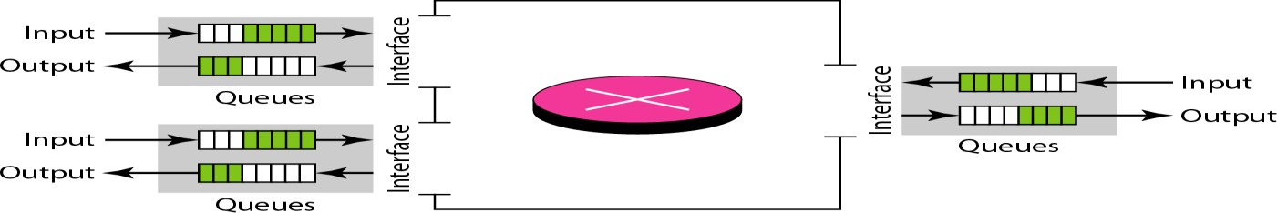
CONGESTION
Congestion: the load on the network is greater than the capacity of the network
Congestion control: the mechanisms to control the congestion and keep the load below the capacity
Congestion occurs because routers and switches have queues- buffers that hold
the packets before and after processing
The rate of packet arrival > packet processing time → input queue longer The packet departure time < packet processing time → output queue longer
24-57

Slide 3

CONGESTION CONTROL
Congestion control refers to techniques and mechanisms that can either prevent congestion, before it happens, or remove congestion, after it has happened.
Two broad categories: open-loop congestion control (prevention) and
closed-loop congestion control (removal).
24-58

Slide 4
Open Loop Congestion Control
Retransmission Policy:
  If the sender feels that a sent packet is lost or corrupted, the packet needs to be retransmitted.
  The retransmission policy and the retransmission timers must be designed to optimize efficiency and at the same time prevent congestion.
Window Policy:
  The type of window at the sender may also affect congestion.
  The Selective Repeat window is better than the Go-Back-N window for congestion control.
  In the Go-Back-N window, when the timer for a packet times out, several packets may be resent, although some may have arrived safe and sound at the receiver.

Slide 5
Acknowledgement Policy:
  If the receiver does not acknowledge every packet it receives, it helps prevent congestion.
Discarding Policy:
  In this policy less sensitive packets may be discarded when congestion is likely to happen
Admission Policy:
  A router can deny establishing a virtual circuit connection if there is congestion in the network or if there is a possibility of future congestion.

Slide 6

Closed Loop Congestion Control
Backpressure
  It is a node-to-node congestion control that starts with a node and propagates, in the opposite direction of data flow, to the source.
  The backpressure technique can be applied only to virtual circuit networks, in which each node knows the upstream node from which a flow of data is coming.

Slide 7

Choke Packet:
  A choke packet is a packet sent by a node to the source to inform it about congestion.
  The warning is from the router, which has encountered congestion, to the source station directly.

Slide 8
Implicit Signalling:
  there is no communication between the congested node or nodes and the source.
  The source guesses that there is a congestion somewhere in the network from other symptoms.
Explicit Signaling:
  The node that experiences congestion can explicitly send a signal to the source or destination.
    Backward Signaling A bit can be set in a packet moving in the direction opposite to the congestion. This bit can warn the source that there is congestion and that it needs to slow down to avoid the discarding of packets.
    Forward Signaling A bit can be set in a packet moving in the direction of the congestion. This bit can warn the destination that there is congestion.

Slide 9

Quality of Service (QoS)
Quality of Service can be defined as something a flow seeks to attain.
Flow Characteristics:

Slide 10
Techniques to Improve QoS
Scheduling
Traffic Shaping
Resource Reservation
Admission Control

Slide 11


Scheduling
FIFO Queuing
Priority Queuing

Slide 12

Weighted Fair Queuing

Slide 13


Traffic Shaping
Leaky Bucket

Slide 14
Traffic Shaping
In the figure, we assume that the network has committed a bandwidth of 3 Mbps for a host.
The use of the leaky bucket shapes the input traffic to make it conform to this commitment.

Slide 15
Token Bucket
The leaky bucket is very restrictive. It does not credit an idle host. For example, if a host is not sending for a while, its bucket becomes empty. Now if the host has bursty data, the leaky bucket allows only an average rate. The time when the host was idle is not taken into account.

Slide 16
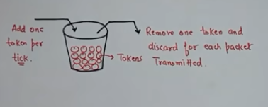
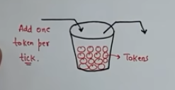
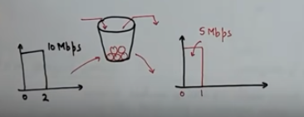
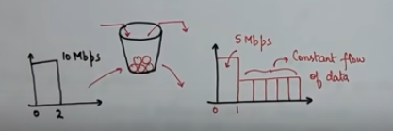
Token Bucket

Slide 17

Token Bucket

Slide 18
Token Bucket
The token bucket algorithm allows idle
hosts to accumulate credit for the future in the form of tokens.
For each tick of the clock, the system sends n tokens to the bucket.

Slide 19
Token Bucket
The system removes one token for every cell (or byte) of data sent. For example, if n is 100 and the host is idle for 100 ticks, the bucket collects 10,000 tokens. Now the host can consume all these tokens in one tick with 10,000 cells, or the host takes 1000 ticks with 10 cells per tick. In other words, the host can send bursty data as long as the bucket is not empty. Figure 24.21 shows the idea.
The token bucket can easily be implemented with a counter.
The token is initialized to zero.
Each time a token is added, the counter is incremented by 1.
Each time a unit of data is sent, the counter is decremented by 1.
When the counter is zero, the host cannot send data.

Slide 20
Token Bucket

